Slide 1
Chapter 12 repeat

Slide 2
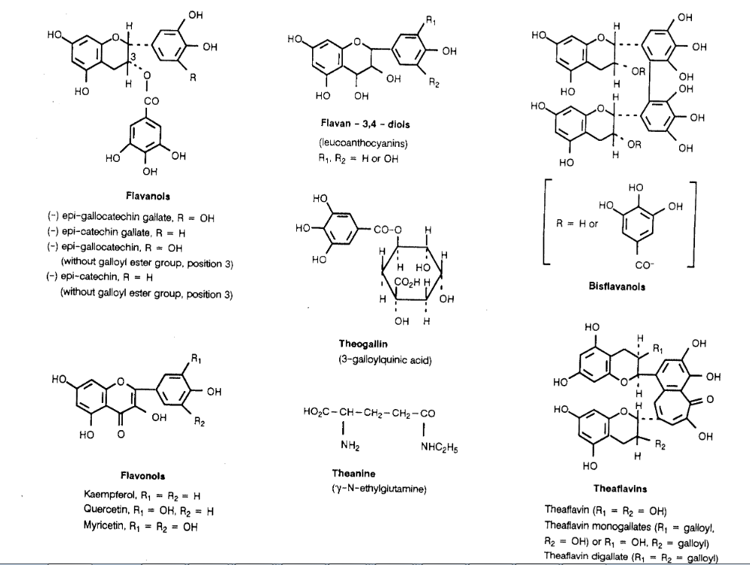

Slide 3
Black tea

Slide 4
Biological Oxidation-Reduction
Oxidoreductases catalyze biological redox reactions
Coenzymes (organic molecules) are required to donate or accept hydrogen
NAD⁺ is a common coenzyme
12.6 Oxidation and Reduction in Living Systems

Slide 5
Oxidation of ethanol

Slide 6
NAD

Slide 8
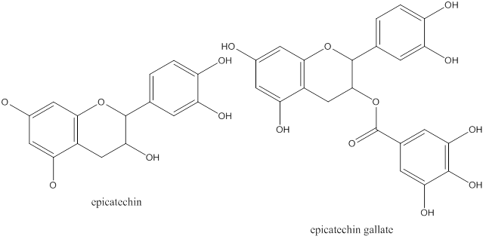
Green tea

Slide 9
Coenzyme A

Slide 10
Garlic

Slide 11
Resveratrol

Slide 12
Oxidation
C₆H₁₂O₆ + O₂ ? CO₂ + ?H₂O + energy

Slide 13
Dihydroxyacetone

